Slide 1

Honda pilot case study
Overview here

Slide 2
Overview

Slide 3
Financial statement

Slide 4
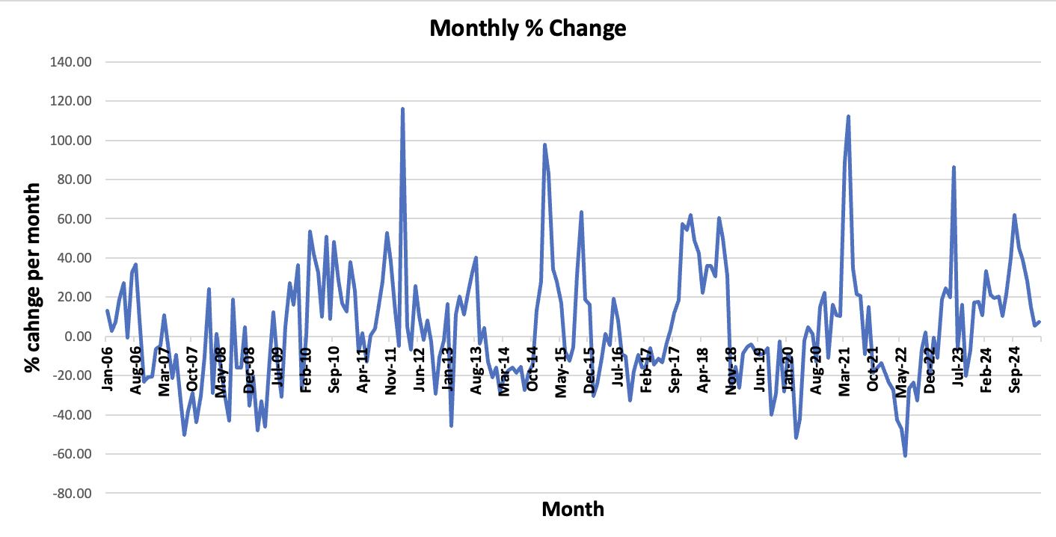
Monthly descriptive analysis

Slide 5
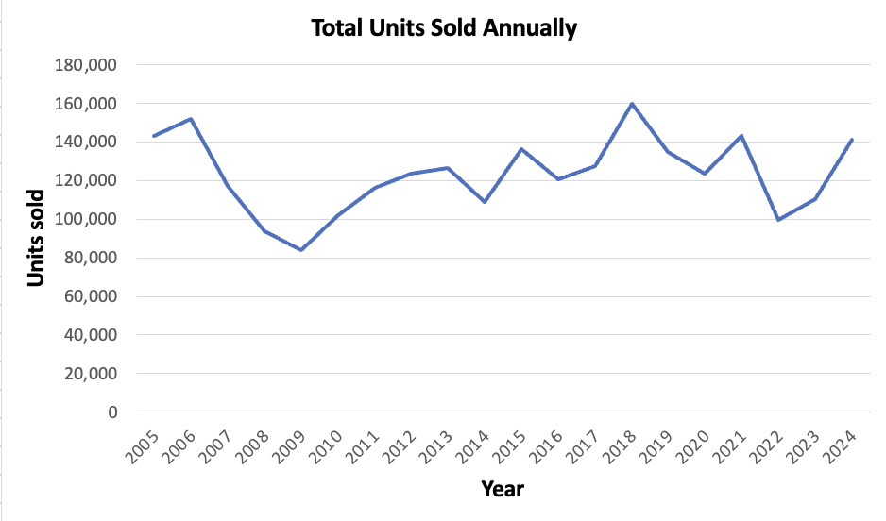
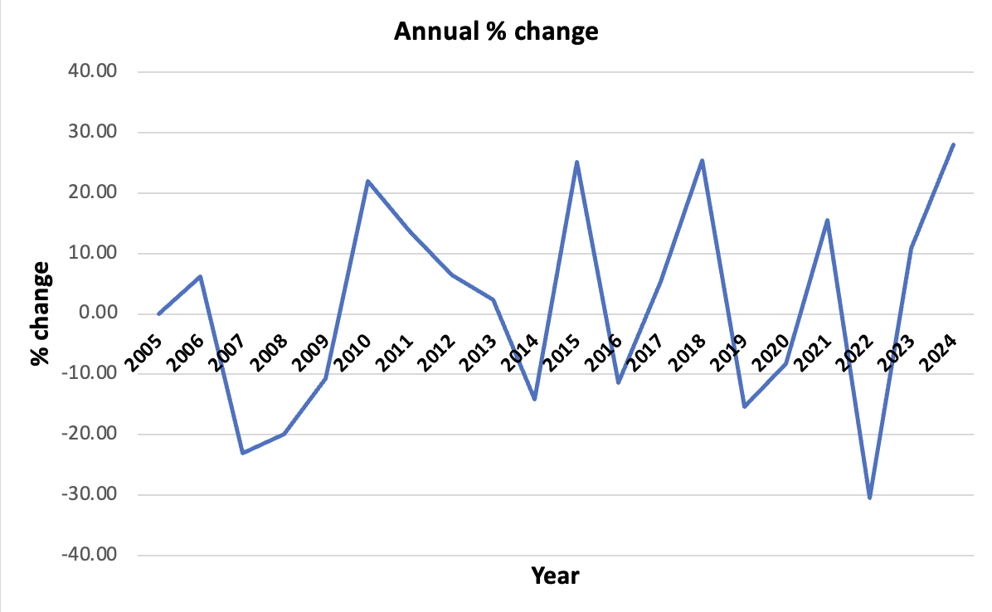
Annual descriptive analysis
Notes:
Both graphs are stationary
We can see that the total units sold annually dropped significantly in 2006 but picked up again after 2009

Slide 6
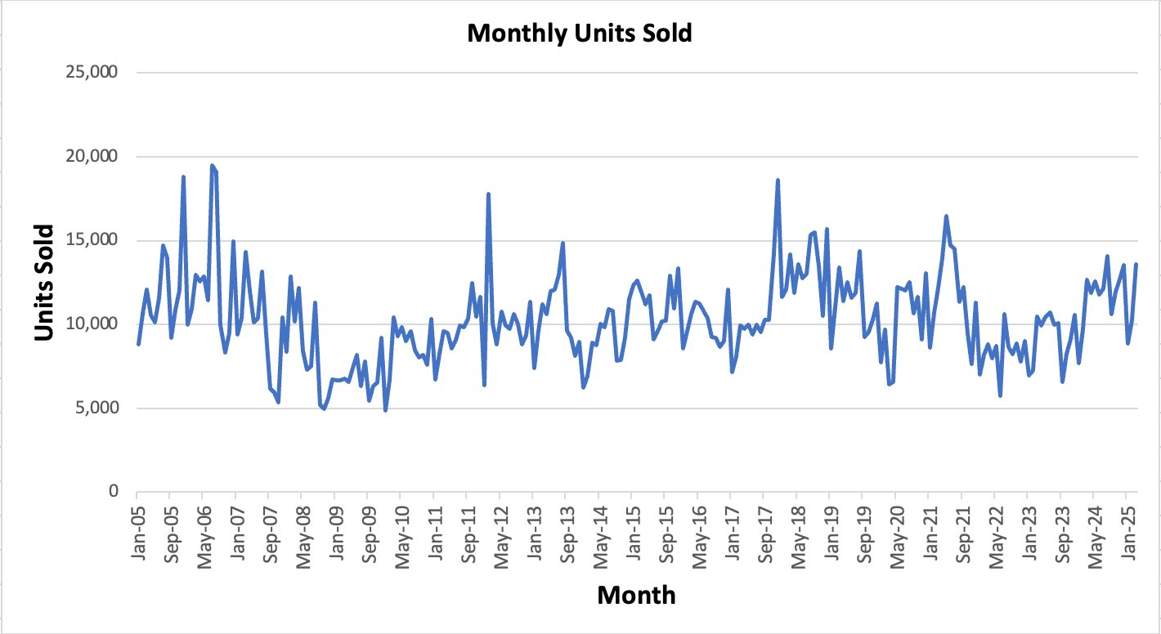

Stationary analysis
Notes:
We graphed the units sold by year and we confirmed that the graph and stationary
There are no trends, cycles, or seasonal effects
Since this was the case, we did not have to compute the % change for the units sold

Slide 7
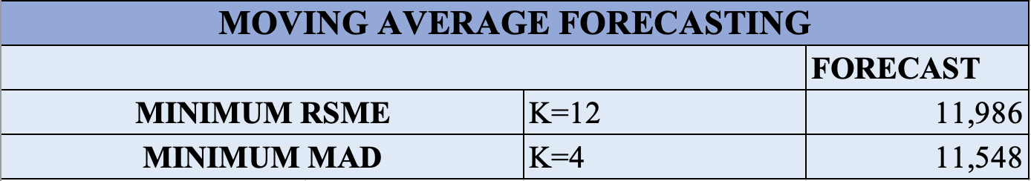
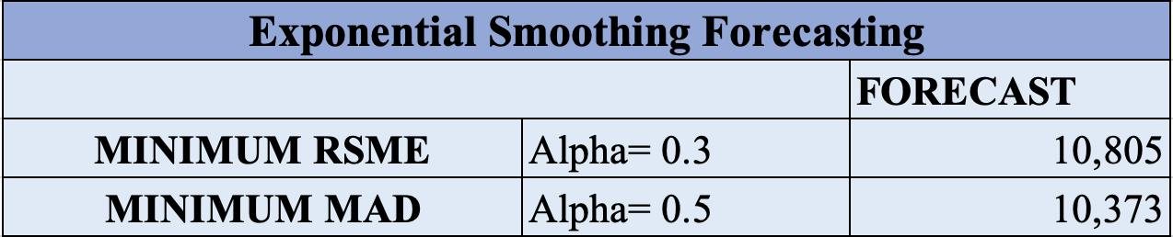
Forecasting analysis
Notes:
Since the units sold is a stationary graph like seen on the last slide, we used this information for the forecasting techniques
First, we computed the moving average forecasting technique which is defined as a smoothing method based on the idea of averaging random fluctuations in the time series to identify the underlying direction in which the time series is changing.
For the min RSME, the optimal number of K was 12, which shows a forecast of 11,986 units sold in April
For the min MAD, the optimal number K was 4, which shows a forecast of 11,548 units sold in April
After this, we computed the exponential smoothing technique, which is defined as a versatile approach for short-range forecasting
For the min RSME, the optimal level of alfa was 0.3, which shows a forecast of 10,805 units sold in April
For the min MAD, the optimal level of alfa was 0.5, which shows a forecast of 10,373 units sold in April

